Slide 1



Managing Smartphone Cloud Testbeds
Demetris Zeinalipour
Data Management Systems Laboratory
Department of Computer Science
University of Cyprus
http://dmsl.cs.ucy.ac.cy/
Talk at the Distributed Systems Laboratory,
Technical University of Vienna, Vienna, Austria, September 30, 2014.
http://smartlab.cs.ucy.ac.cy/

Slide 2


Talk Objectives
Review abstractions comprising SmartLab, a Mobile Infrastructure-as-a-Service cloud we have developed at the University of Cyprus.
Overview experiences from using SmartLab in a research setting.
"Managing smartphone testbeds with smartLab”, 27th USENIX Large Installation System Administration Conference (LISA'13), Washington D.C., USA, Nov. 3–8, 2013.
Summarize related mobile data management research efforts we currently evolve:
Anyplace – Indoor Information Service.
Rayzit – Crowd Messaging Service.

Slide 3

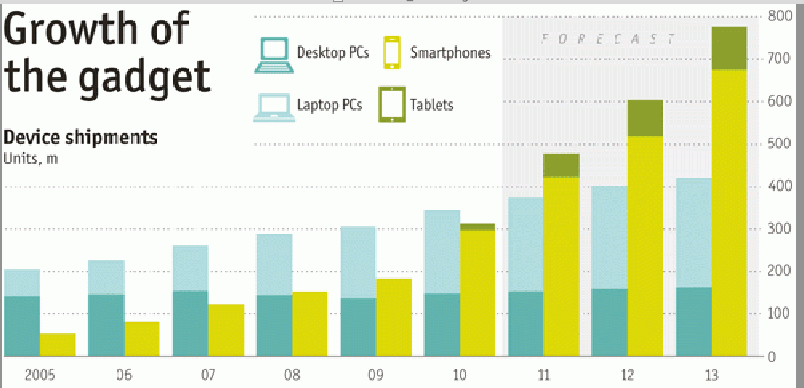


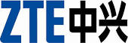
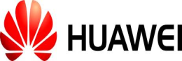
The Smartphone Revolution
October 2011: The Economist. "Beyond the PC"
February 2012: Canalys validated Economist's forecast, initiating the Post-PC era.
April 2013: IDC reports another important development
Smartphone sales exceed the sale of Feature phones for the first time in history due to increased sales in developing regions.
51.6% (216M) Smartphones vs.
48.4% (186M) Feature Phones
Sales (Millions)
Year

Slide 4
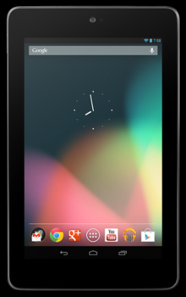
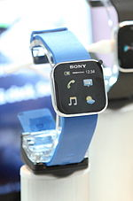
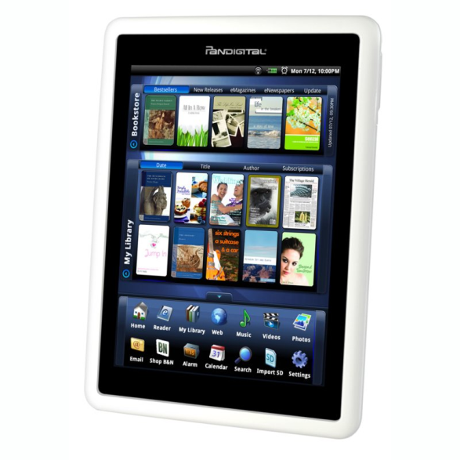
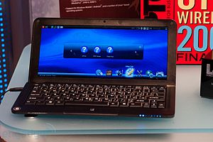
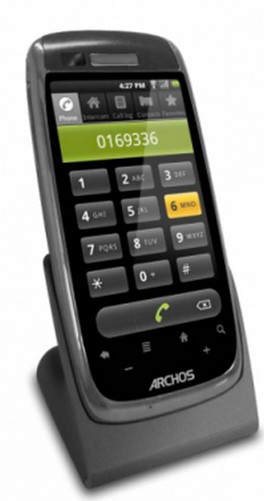
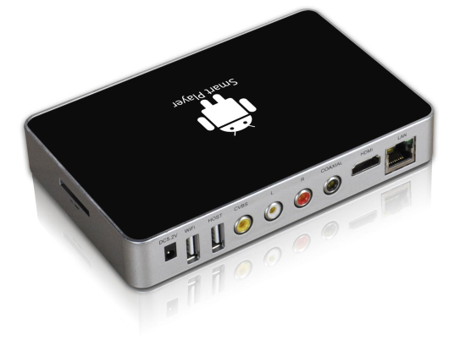
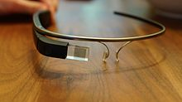
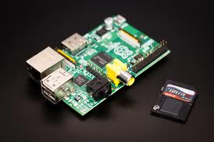
Hardware Fragmentation
Equipment running on Android
(based on Linux kernel 2.6.x and 3.x)
Smart Watches
SmartBooks
Tablets
eReaders
Smart Home Phones
Smart Glasses
Smart TVs
Rasperry PI

Slide 5
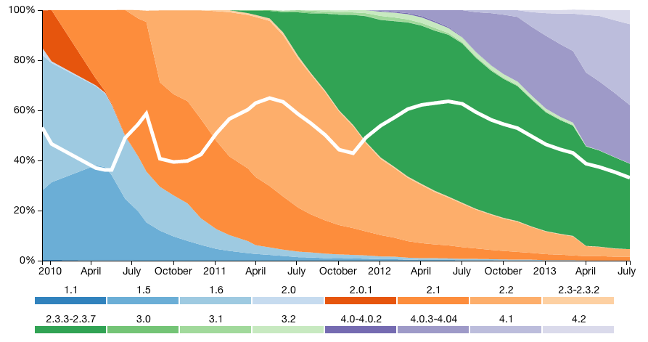
Software Fragmentation
IDC projects that 53% of smartphones in 2016 will be running Android (19% iOS, 19% Win)
Android Software Fragmentation
Source: OpenSignal, July 2013
￼
Smartphone OS landscape is fragmented!

Slide 6
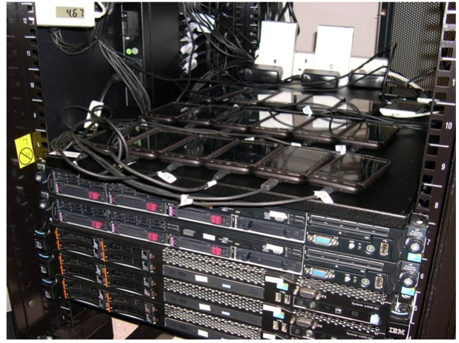
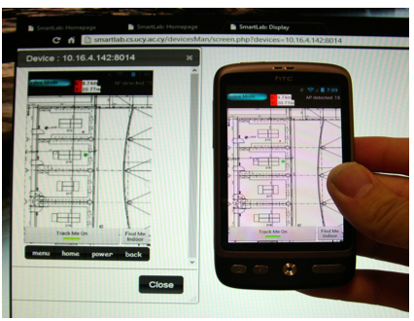
SmartLab: Research Motivation
How can a smartphone developer cope with the software / hardware fragmentation?
We developed a comprehensive architecture for managing static, mobile and virtual smartphones through a web browser.
￼
Static Androids
Moving Androids

Slide 7
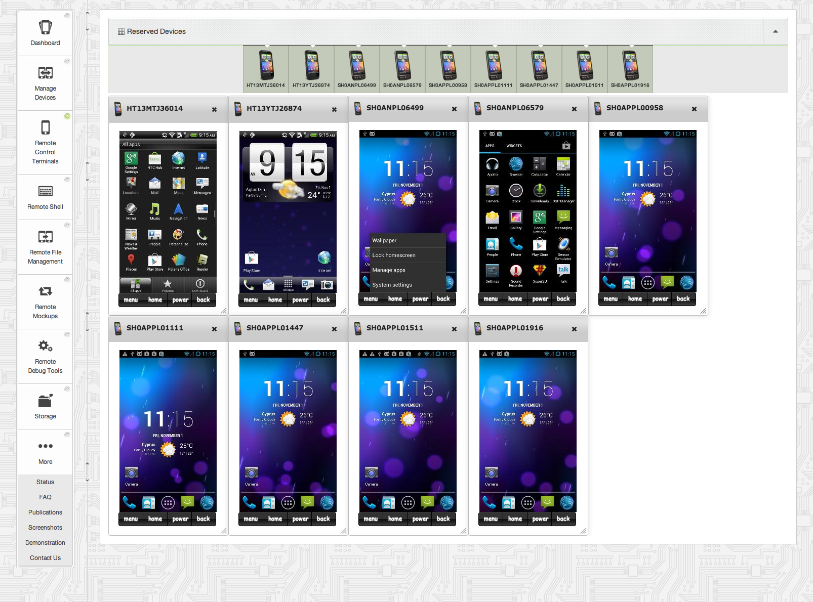
SmartLab: User Interface
Intuitive Web 2.0 GUI (Ajax, JSON, APIs)
Rent
Manage
See/Click
Shell
File Sys.
Automation
Debug
Data
Video!

Slide 8

Use 1: Application Testing
How to test my app automatically on 50 different smartphones?
Smartphone App Developers are troubled with Quality Assurance on a fragmented ecosystem.
Users are frustrated by poorly tested applications, which result in poor ratings.
￼
(Enterprise) Industrial Interest: Mobile testing, quality monitoring, and security a $8-9B market!
Israeli Perfectomobile raised $35M, employs 130 people and expects $100M sales by 2016.
US Keynote Deviceanywhere, employs 119 people and integrates in HP’s Unified Functional Testing (UFT) regression testing tool.
Samsung Remote Test Lab (RTL), mainly for single device testing & those are simulated.
Source: PerfectoMobile.com

Slide 9
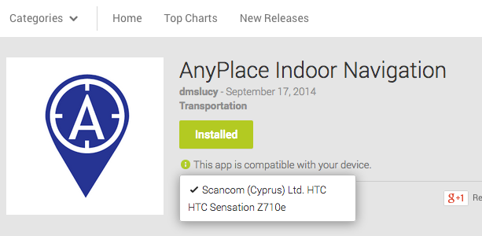
Use 2: Personal Gadget Management
How to manage my personal gadgets (or Android x86 Netbooks) at a fine-grain (i.e., remote terminal, clicks, files, etc.)?
Currently the various App markets (e.g., Play Store), allow you primitive device management (e.g., install new apps).
￼

Slide 10



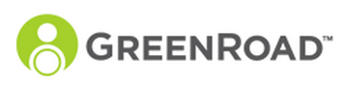
Use 3: Data Collection in Smart Cities
How to handle a fleet of Android-powered equipment installed on 1000 buses?
e.g., Smart Advertising Panels & TVs, WiFi/3G Hotspots, and TVs, Multimedia equipment, etc.
Traditional Fleet Management Systems: focus more on specialized hardware/software for:
vehicle maintenance, telematics (tracking and diagnostics), driver management, speed & fuel management, security.
Fleet Management for Smartphones: try to offer fleet management utility through the driver’s smartphones, mainly by user input.
No low-level control, rather input-oriented apps apps

Slide 11
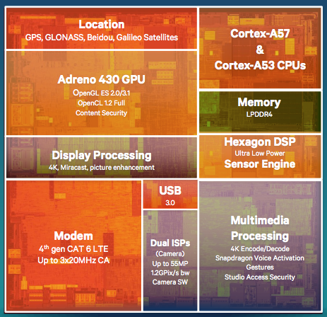
Use 4: Computational Clusters?
How to build beowulf-like clusters out of deprecated smartphones?
We tend to change smartphones faster than PCs.
The gap between x86 (still faster) and ARM architectures (greener) is slowly closing.
e.g., Latest Smartphone CPU (Qualcomm Snapdragon 810)
4 x A57 (faster) cores + 4 A53 (eco) cores with 64 bit support and 20nm device fabrication.
Indicative benchmark by Geekbench (4.5:1 ratio):
- Xeon X5650 Score (6-cores, 2.67GHz): 13,703
- Snapdragon 801 (4-cores, 2.45GHz): 2,924
Source: http://goo.gl/vYJZCJ

Slide 12

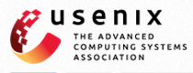
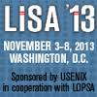
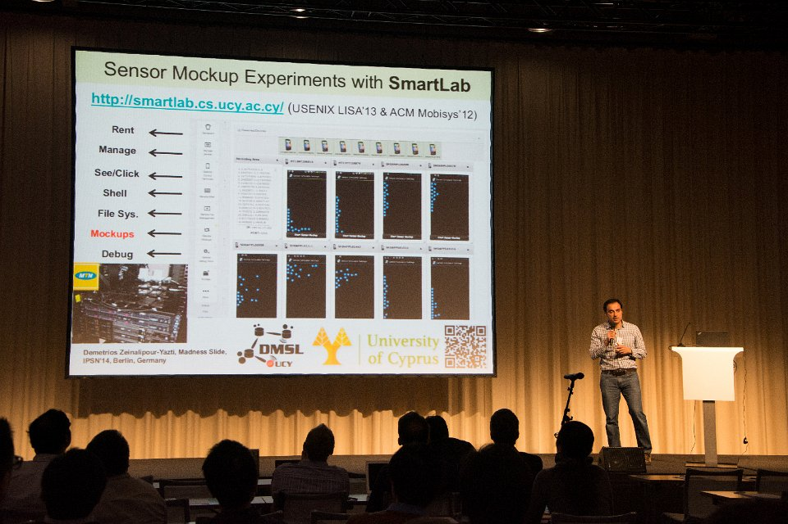
Publication History of SmartLab
"Demo: a programming cloud of smartphones”, In 10th ACM International Conference on Mobile Systems Applications and Services (Mobisys '12), Lake District, UK, 2012.
"Managing smartphone testbeds with smartLab”, 27th USENIX Large Installation System Administration Conference (LISA'13), Washington D.C., USA, Nov. 3–8, 2013.
“Sensor Mockup Experiments with SmartLab", Demo at 13th ACM Intl. Conference of Information Processing in Sensor Networks (IPSN'14), Berlin, Germany, 2014.
"Managing big data experiments on smartphones", Distributed and Parallel Databases (DAPD '14), Springer US, 2014 (accepted).

Slide 13
Presentation Outline
Introduction
Related Work
SmartLab Architecture & Experiments
Power and Connectivity
Android Debug Bridge (ADB)
Device Server (DS)
Security Issues
User Interface (UI)
Mockup Experiments
Anyplace Overview
Rayzit Overview

Slide 14
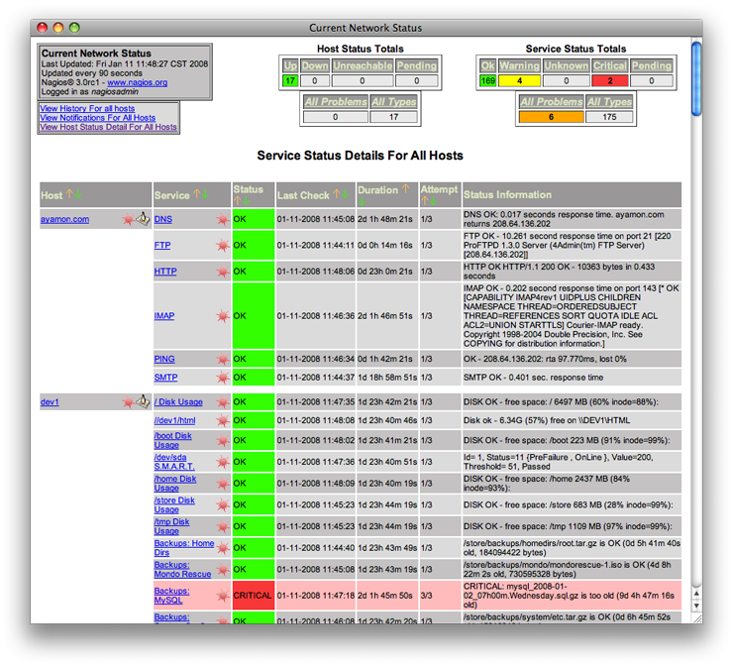
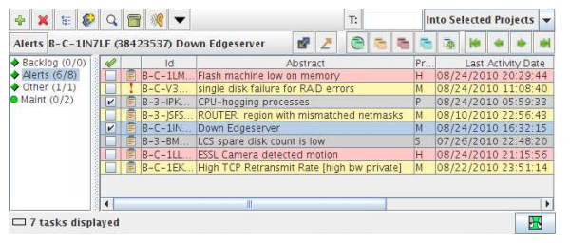
Related Work
Remote Server Monitoring Solutions
e.g. Nagios, Akamai CDN Query System (LISA'10), Amazon EC2, VMWare VCenter/ESXi, etc.
￼
Akamai Query System
NAGIOS
No support for mobile phones!

Slide 15
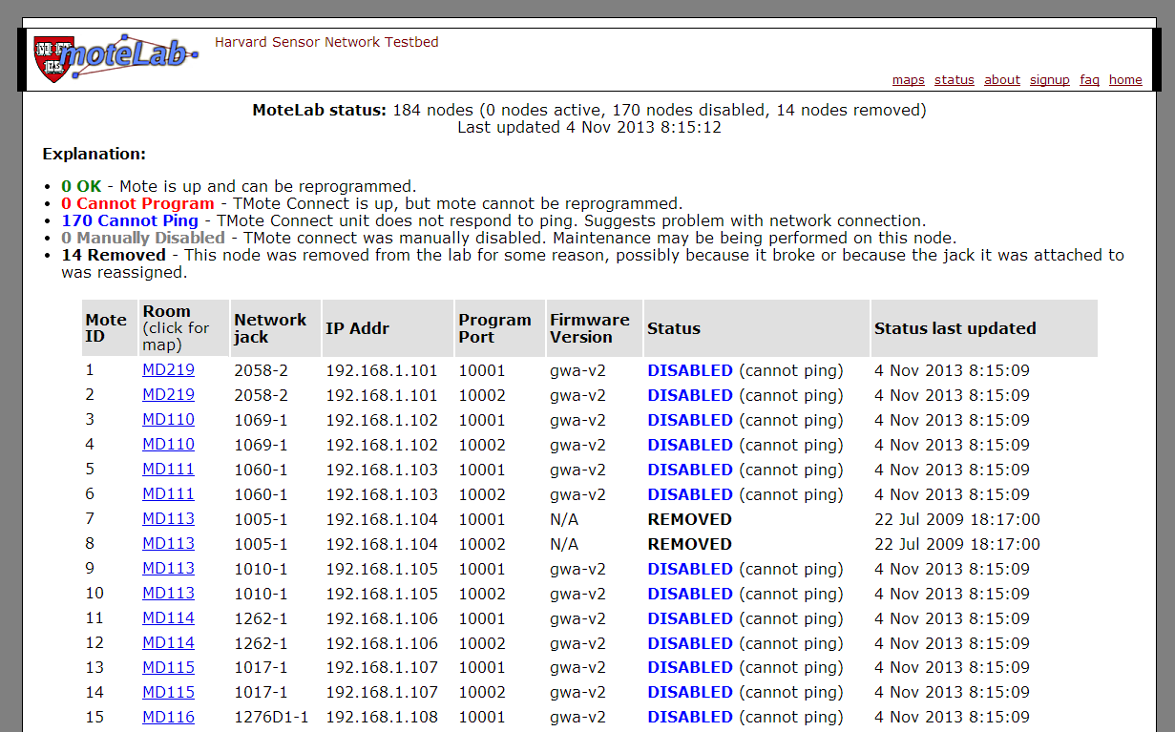
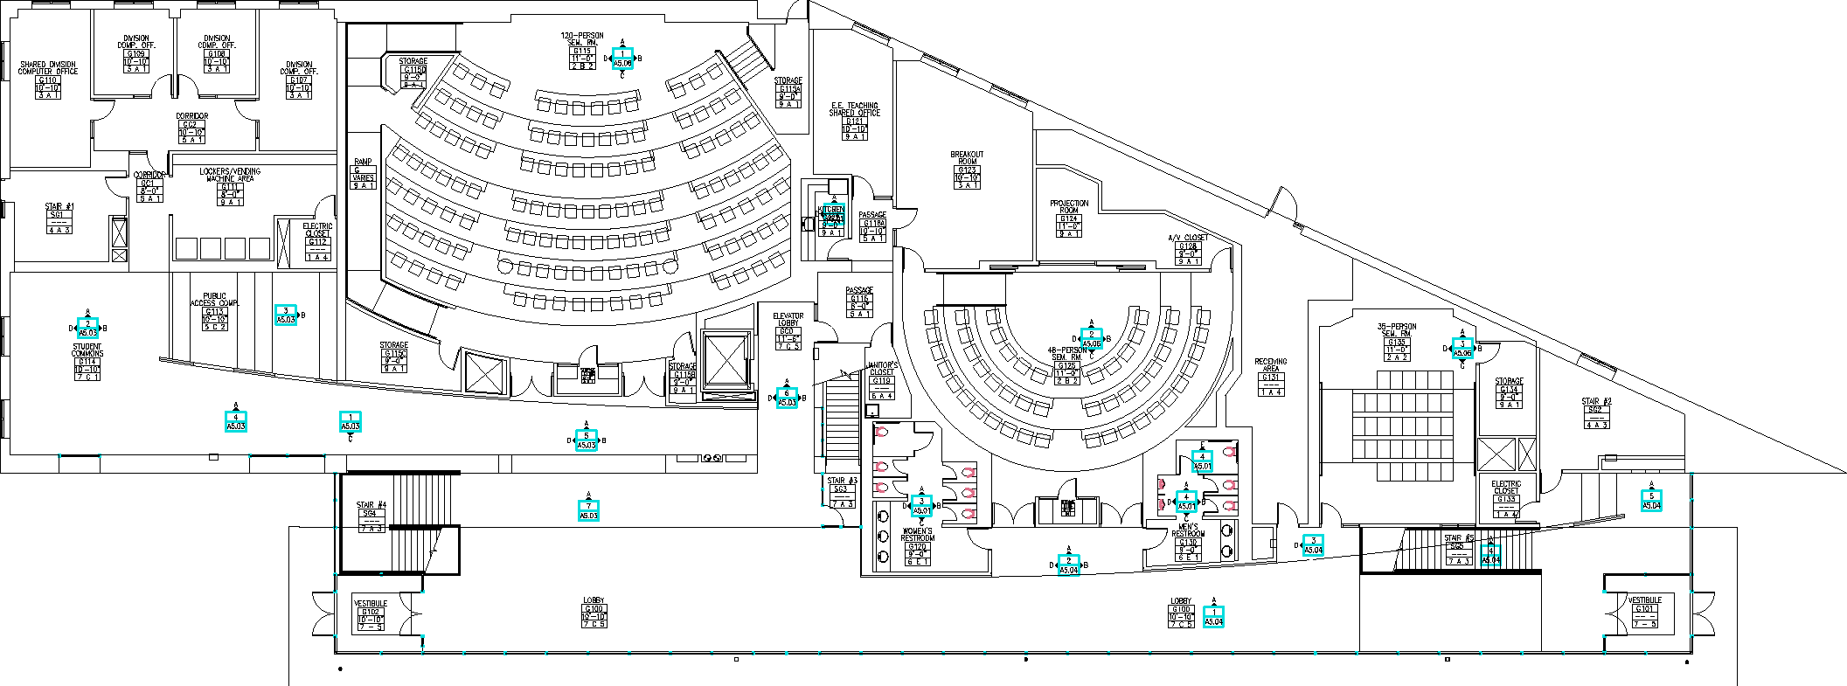

Related Work
Wireless Sensor Network Testbeds
e.g. MoteLab (Harvard), CitySense (Harvard), Wisibed (EU), etc.
￼
Again, no support for mobile phones!

Slide 16


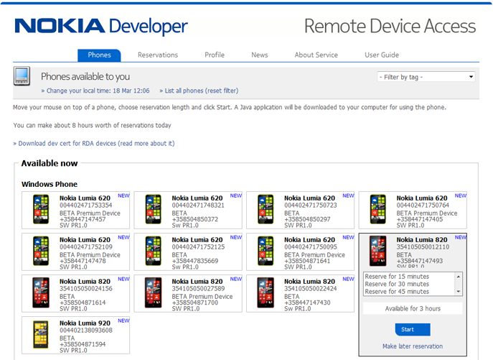
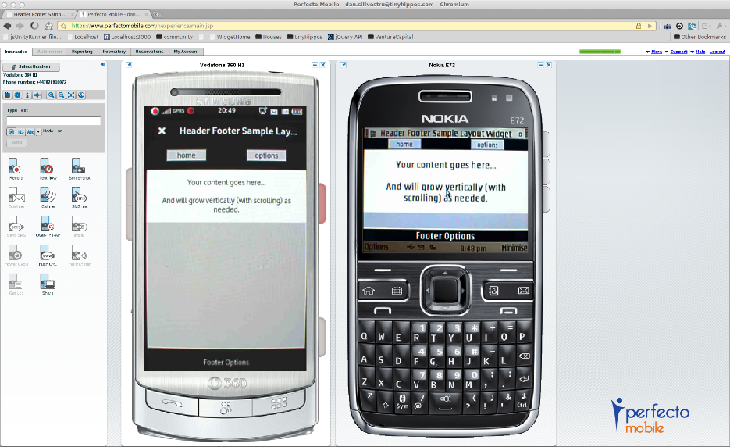
Related Work
Real Mobile Testbeds
e.g., Nokia RDA (only windows and symbian, real), PerfectoMobile (commercial, real), Keynote's Device Anyware (commercial, real)
￼
Geared towards individual device testing.
No insights into how these are developed!

Slide 17
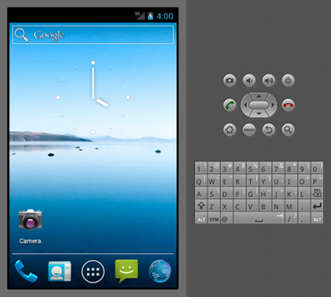
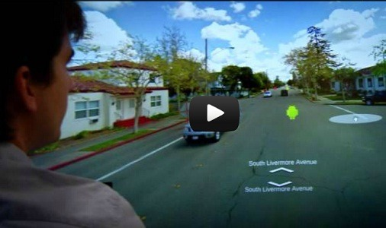
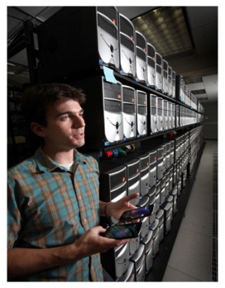
Related Work
Emulated (on PCs) Mobile Testbeds
QEMU (Quick EMUlator) Clusters:
QEMU is a generic and open source machine emulator (e.g., run ARM-compiled code on x86)
Android-X86 Clusters:
The Android-X86 provides Android for x86 architectures, thus Android can run on an ordinary PC or in the Cloud.
The project was conceived when trying to offer Android on Asus Eee ultrabooks.
Both require a lot of RAM on the host!
No real computing stack, no sensors!
Besides Samsung RTL, Megadroid is a 520-node PC cluster, deployed by Sandia Labs (US) that deploys 300,000 Android Emulators.
Facilitates capacity-type cluster security simulations
QEMU Emulator in eClipse
￼

Slide 18

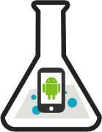
Related Work
People-centric Testbeds
PhoneLab (Univ. of Buffalo, USA with support by Google): allows data collection from real users.
Workflow:
Register Experiment
Upload Android Executable with Log.v(ID, “Something”)
Institutional Review Board Evaluation / Approval
Pre-deployment Testing (battery, storage, etc.)
Deployment (up to 152 participants)
PhoneLab returns Logcat trace containing ID.
https://www.phone-lab.org/
No fine-grain control over remote devices!

Slide 19
Presentation Outline
Introduction
Related Work
SmartLab Architecture & Experiments
Power and Connectivity
Android Debug Bridge (ADB)
Device Server (DS)
Security Issues
User Interface (UI)
Mockup Experiments
Anyplace Overview
Rayzit Overview

Slide 20
SmartLab Architecture
WWW User
HTTPS / WSS
F I R E W A L L
S M A R T L A B
User Interface (UI) Layer (Web Server)
Data Layer
RFM
RCT
RDT
RS
RM
S S HF
S
SmartLab DB
ATP
Device Server (DS) Layer
File
System
RFM
RCT
RDT
RS
RM
S S HF
S
Android or Socket Debug Bridge (ADB | SDP)
JDWP
SSHFS
Hardware Layer / SmartPhones

Slide 21
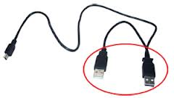
Connectivity and Power Issues
Connectivity: A host running the Device Server has a limited number of physical USB ports.
We user “USB Daisy Chaining (up to 127 devices)”, i.e., Smartphone => Hub (USB:2.0 | 480Mbps) => Hub (USB:3.0 | 5Gbps) => Device Server
Power: Older smartphones need 1A at a max charge cycle while newer / tablets 1.5A. Unfortunately, USB ports on USB provide only 0.5A outlets.
This might result in a negative battery replenishment.
We configure phones with a low LCD brightness.
One might carry out power boosting: 3 x Y-shaped USB cables (i.e., 2x500mA) + 1 x for the next hub

Slide 22
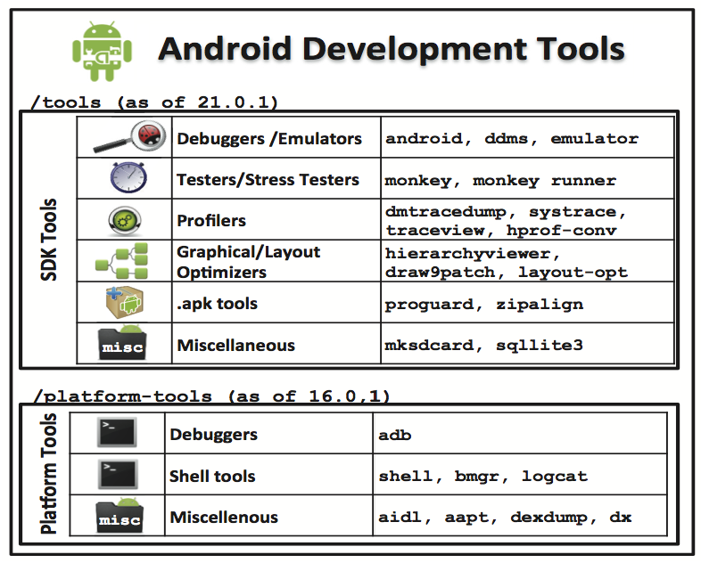
Android Debug Bridge (ADB)
Android bundled a variety of development tools (platform-independent SDK tools + Platform tools).
We re-package our functionality around these tools to easily keep up with updates.
We particularly exploit the Android Debug Bridge (ADB) detailed next.

Slide 23
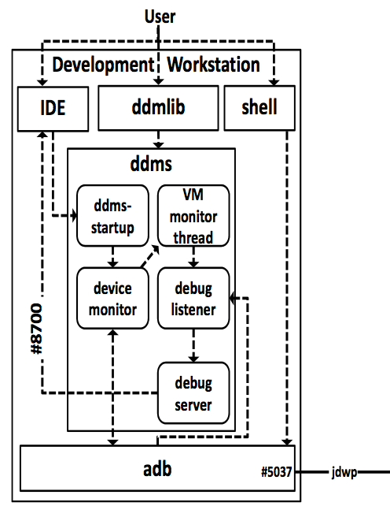
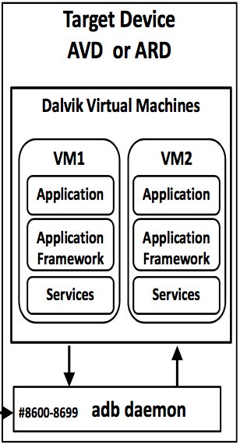
Android Debug Bridge (ADB)
ADB handles the bulk of communication between the connected smartphones and the server (coined the Device Server).
Device Server
Smartphone
Smartphone App
(1 OS Process)

Slide 24

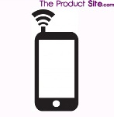
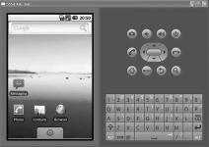
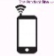

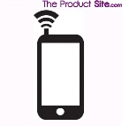

Device Server (DS)
Connection Modalities:
ARD-Local
ARD-Remote
ARD-WiFi
AVD
USB Hub
WiFi AP
1Gbps
VM
1Gbps
USB2.0 480Mbps
USB2.0 480Mbps
300Mbps
DS
DS
DS
DS
Datacenter
Datacenter
Datacenter
Datacenter
Emulator
wired
wireless
virtual
ARD-Local: Android Real Device (ARD) mounted locally to the Device Server (DS) through USB.
ARD-Remote: ARD mounted through a USB port on a gateway PC to DS through a wired network.
ARD-WiFi: ARD connected to DS through a WiFi AP.
AVD: Android Virtual Device running on DS.
ARD-3G

Slide 25
Device Server (DS)
Remote File Management
Expected
Push File (10MB) / Push & Install Application (1MB)
ARDs-Local out-perform all other connectivity modalities
Unexpected
AVD has the lowest performance during (small) installs => QEMU-based AVDs are slow due to ARM emulation and emulated I/O.
For large transfers => the Network becomes the bottleneck.

Slide 26
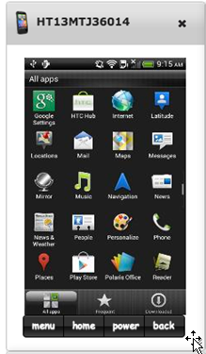
Device Server (DS)
Remote Screen Capture (RCT)
Remotely controlling the screen of a device.
Supports:
Control events (e.g., power, home)
Mouse events (e.g., click, drag)
Keyboard events (e.g., key press)
RCT Implementation Alternatives:
OnDevice: cat /dev/fb0 or /dev/graphics/fb0
OnServer: Monkeyrunner script with takeSnapshot()
OnServer: Continuously listening to the direct stream (compressed or not) that contains the contents of each consecutive screenshot through ddmlib.jar
Evaluated next

Slide 27
Device Server (DS)
Screen Capture Microbenchmark
Smartlab’s screen capture module (with ondevice compression) is faster than taking screenshots 2fps vs. 0.3fps
(480 × 800, 37KB/screenshot)
0.3fps
2fps
Comparison:
Windows Remote Desktop Protocol (RDP) is limited to 30 fps

Slide 28
Device Server (DS)
Screen Capture Microbenchmark (CPU)
Data from System Profiler running on Smartphone
CPU utilization reaches 28±15%
as opposed to 7±3%
without compression
compression
No compression

Slide 29
Device Server (DS)
Screen Capture Microbenchmark (Power)
More CPU => Higher power consumption
(≈500%)
Future Work:
Auto switch between 2 modes (i.e., compression vs. no-compression)
compression
No compression

Slide 30
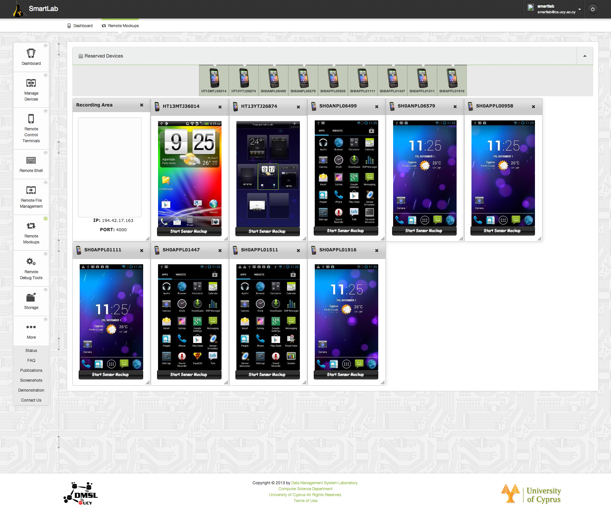
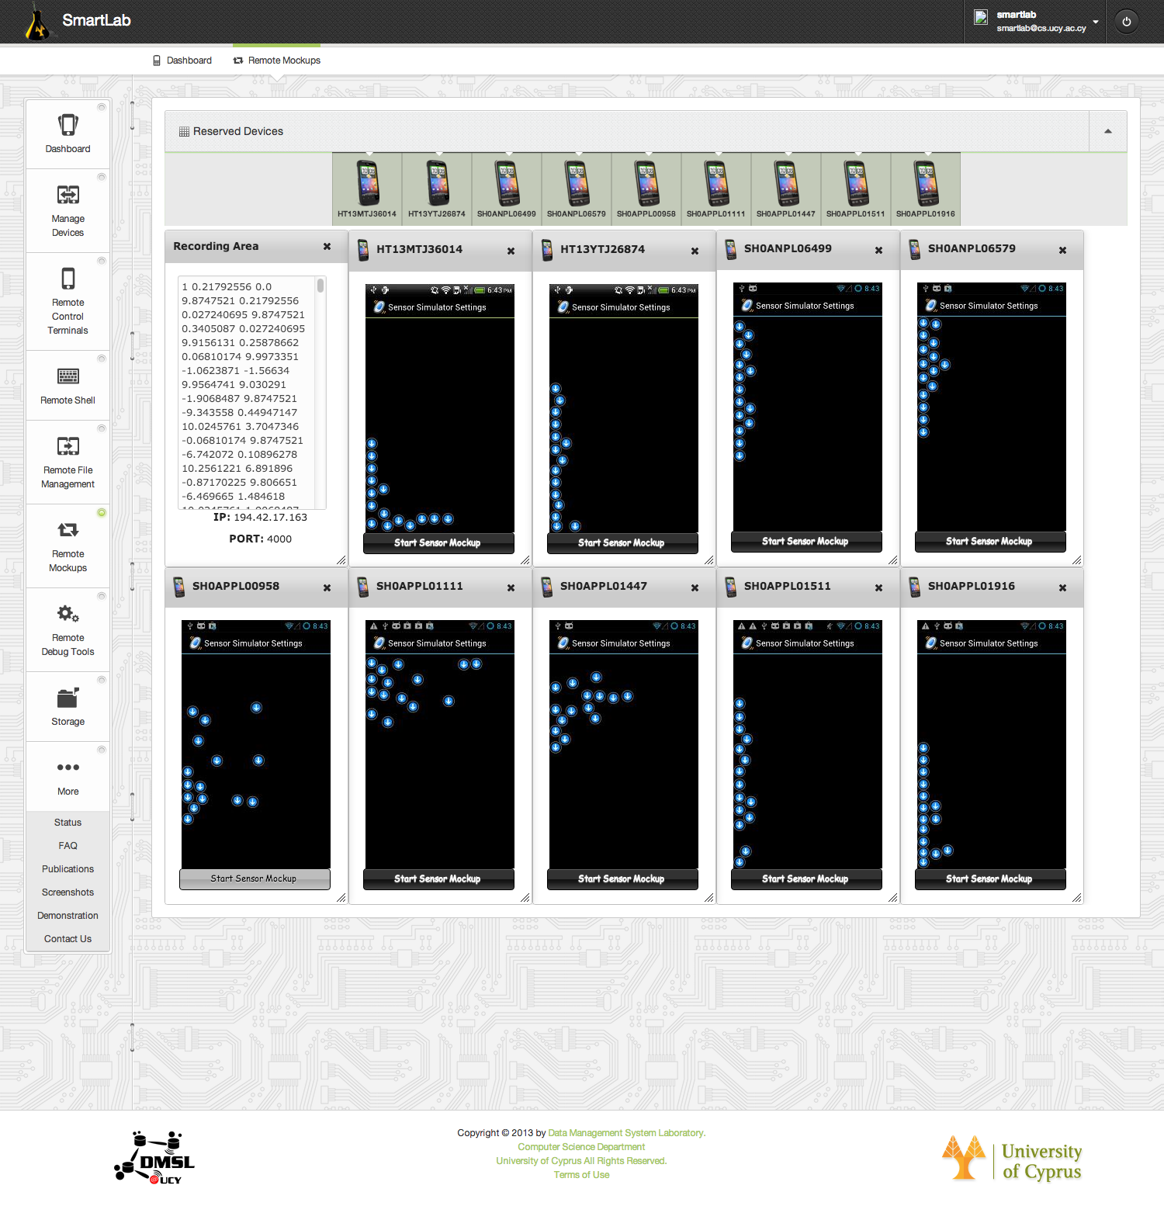
User Interface
Remote Sensor Mockup (RM)
VIDEO!
Mockup Sensors
GPS mockup
Accelerometer sensor
Compass sensor
Orientation sensor
Temperature sensor
Light sensor
Proximity sensor
Pressure sensor
Gravity sensor
“Sensor Mockup Experiments with SmartLab", Demo at 13th ACM Intl. Conference of Information Processing in Sensor Networks (IPSN'14), Berlin, Germany, 2014.
"Managing big data experiments on smartphones", Distributed and Parallel Databases (DAPD '14), Springer US, 2014 (accepted).

Slide 31
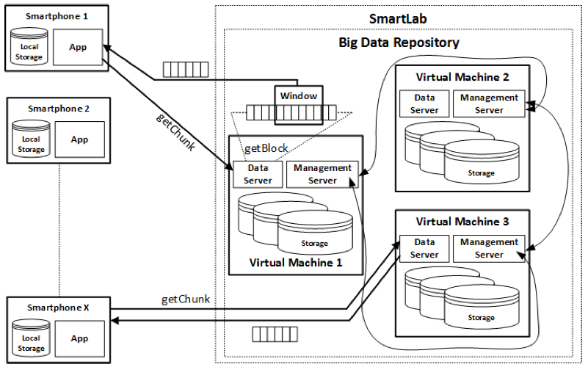
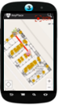
Mockup Experiments
Benchmark Localization Algorithms using SmartLab
Crowdsource RSS of AP in buildings
“Sensor Mockup Experiments with SmartLab", Demo at 13th ACM Intl. Conference of Information Processing in Sensor Networks (IPSN'14), Berlin, Germany, 2014.
"Managing big data experiments on smartphones", Distributed and Parallel Databases (DAPD '14), Springer US, 2014 (accepted).

Slide 32
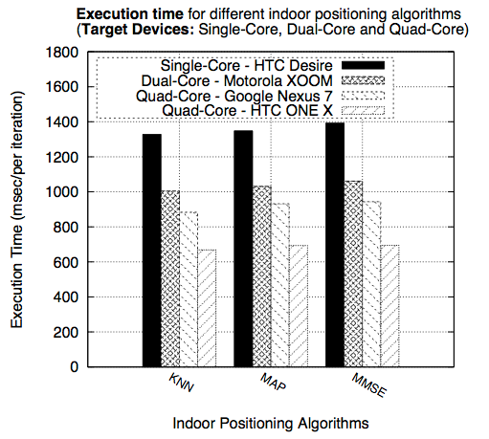
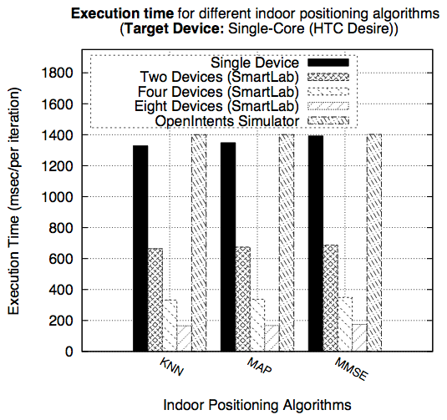
Mockup Experiments
Example Mockup Experiments
A) Testing 3 localization algorithms on multicores.
B) Splitting 450 algorithm iterations over 8 devices
Measure real wall clock time and power!

Slide 33
Presentation Outline
Introduction
Related Work
SmartLab Architecture & Experiments
Power and Connectivity
Android Debug Bridge (ADB)
Device Server (DS)
Security Issues
User Interface (UI)
Mockup Experiments
Anyplace Overview
Rayzit Overview

Slide 34
Anyplace Indoor Information Service
People spend 80-90% of their time inside buildings, while 70% of cellular calls and 80% of data connections originate from indoors.
GPS has low availability indoors due to the blockage or attenuation of the satellite signals but it is also very power hungry.
Smartphones can nowadays localize off-the-shelf with onboard sensors and WiFi signal fingerprints (coined Hybrid Localization)
New Applications:
In-building Navigation (Malls, Airports, Museums, Schools, etc.)
Asset Tracking and Inventory Management (Hospitals, etc)
Elderly support for Ambient and Assisted Living (AAL)
Augmented Reality (Firefighters), Social Networking, etc.

Slide 35
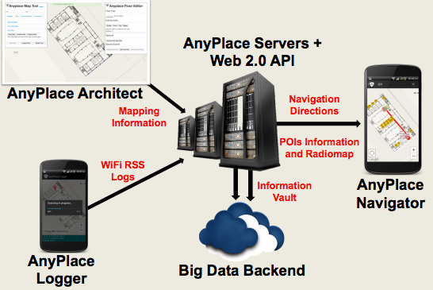
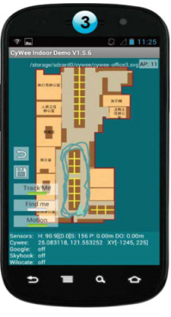
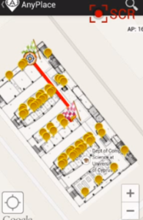
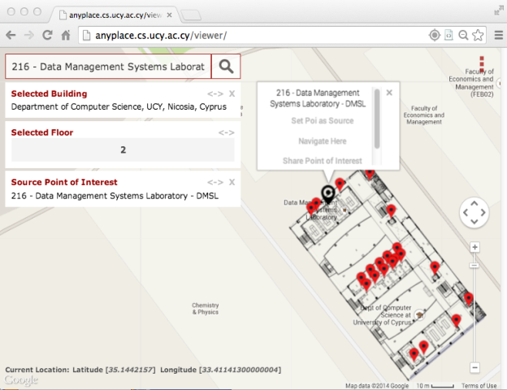
Anyplace Indoor Information Service
Anyplace Architecture
Navigator
Viewer, Widget

Slide 36

Anyplace Indoor Information Service
Available at: http://anyplace.cs.ucy.ac.cy/
VIDEO!

Slide 37

Anyplace Indoor Information Service
References
[Airplace] "The Airplace Indoor Positioning Platform for Android Smartphones", C. Laoudias et. al., Best Demo Award at IEEE MDM'12. (Open Source!)
[HybridCywee] "Demo: the airplace indoor positioning platform", C.-L. Li, C. Laoudias, G. Larkou, Y.-K. Tsai, D. Zeinalipour-Yazti and C. G. Panayiotou, in ACM Mobisys'13. Video at: http://youtu.be/DyvQLSuI00I
[UcyCywee] IPSN’14 Indoor Localization Competition (Microsoft Research), Berlin, Germany, April 13-14, 2014. 2nd Position! http://youtu.be/gQBSRw6qGn4
[Anyplace] Crowdsourced Indoor Localization and Navigation with Anyplace, In ACM/IEEE IPSN’14
1st Position at EVARILOS Open Challenge, European Union (TU Berlin, Germany).
Cywee / Airplace
VIDEO!

Slide 38
Presentation Outline
Introduction
Related Work
SmartLab Architecture & Experiments
Power and Connectivity
Android Debug Bridge (ADB)
Device Server (DS)
Security Issues
User Interface (UI)
Mockup Experiments
Anyplace Overview
Rayzit Overview

Slide 39
Crowd Micro-blogging
Social Media (Facebook, Linked-in, … ) utilize a Social Graph (friendship, follower, followee) to map the relationships between users.
Challenges
Applications many times require location-based rather than social-based interactions, e.g.,
Inform my neighboring drivers about an accident (e.g., in Waze).
Inform people in a neighborhood about an event.
Location-based services suffer from bootstrapping
e.g., Check in to Foursquare and find nobody else there
Interacting with the Crowd, calls for stronger Privacy!

Slide 40


Crowd Micro-blogging
We developed Rayzit for Windows Phone after receiving an Industrial Award by the Appcampus Program (Microsoft, Nokia & Aalto, Finland).
Ranked among the 5 best apps of the given program among 3500 submissions.
A few thousand downloads and active users on our big-data backend.
http://rayzit.com/

Slide 41

Crowd Micro-blogging
rayzit.com User Map
Research: Paper currently under submission investigating big-data processing operator to the Distributed AKNN Query.

Slide 42


Crowd Micro-blogging
Distributed All k Nearest Neighbor Query

Slide 43
Managing Smartphone Cloud Testbeds
Demetris Zeinalipour
Thanks! Questions?
Data Management Systems Laboratory
Department of Computer Science
University of Cyprus
http://dmsl.cs.ucy.ac.cy/
Talk at the Distributed Systems Laboratory,
Technical University of Vienna, Vienna, Austria, September 30, 2014.
http://smartlab.cs.ucy.ac.cy/

